Slide 1
Functional
Dependencies and Normalization

Slide 2
Introduction
Each relation schema consists of a number of attributes, and the relational database schema consists of a number of relation schemas.
Used to measure the quality of the design
To measure formally why one set of groupings of attributes into relation schemas is better than another.
There are two levels at which we can discuss the goodness of relation schemas
  Logical level
  Physical level

Slide 3
Informal Design Guidelines for Relation Schemas
Making sure that the semantics of the attributes is clear in the schema
Reducing the redundant information in tuples
Reducing the NULL values in tuples
Disallowing the possibility of generating spurious tuples

Slide 4
Imparting Clear Semantics to Attributes in Relations
Guideline 1:
  Design a relation schema so that it is easy to explain its meaning. Do not combine attributes from multiple entity types and relationship types into a single relation. Intuitively, if a relation schema corresponds to one entity type or one relationship type, it is straightforward to interpret and to explain its meaning. Otherwise, if the relation corresponds to a mixture of multiple entities and relationships, semantic ambiguities will result and the relation cannot be easily explained.

Slide 5
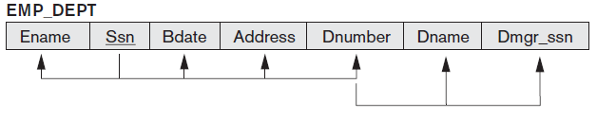
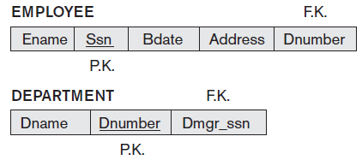
Although there is nothing wrong logically with these two relations, they violate Guideline 1 by mixing attributes from distinct real-world entities.

Slide 6
Redundant Information in Tuples and Update Anomalies
One goal of schema design is to minimize the storage space used by the base relations (and hence the corresponding files). Grouping attributes into relation schemas has a significant effect on storage space.
Storing natural joins of base relations leads to an additional problem referred to as update anomalies. These can be classified into insertion anomalies, deletion anomalies, and modification anomalies.
  Insertion Anomalies
  Deletion Anomalies
  Modification Anomalies

Slide 7
Guideline 2
Design the base relation schemas so that no insertion, deletion, or modification anomalies are present in the relations. If any anomalies are present, note them clearly and make sure that the programs that update the database will operate correctly.

Slide 8
NULL Values in Tuples
Guideline 3:
  As far as possible, avoid placing attributes in a base relation whose values may frequently be NULL. If NULLs are unavoidable, make sure that they apply in exceptional cases only and do not apply to a majority of tuples in the relation.

Slide 9
Generation of Spurious Tuples
A tuple is a record in a database
A spurious tuple is a record in a database that gets created when two tables are joined badly, that is join is performed on an attribute that is neither a primary key or a foreign key.
Guideline 4:
  Design relation schemas so that they can be joined with equality conditions on attributes that are appropriately related (primary key, foreign key) pairs in a way that guarantees that no spurious tuples are generated. Avoid relations that contain matching attributes that are not (foreign key, primary key) combinations because joining on such attributes may produce spurious tuples.

Slide 10
Summarization
Anomalies that cause redundant work to be done during insertion into and modification of a relation, and that may cause accidental loss of information during a deletion from a relation.
Waste of storage space due to NULLs and the difficulty of performing selections, aggregation operations, and joins due to NULL values
Generation of invalid and spurious data during joins on base relations with matched attributes that may not represent a proper (foreign key, primary key) relationship

Slide 11
Functional Dependencies
A formal tool for analysis of relational schemas that enables us to detect and describe some of the above-mentioned problems in precise terms.
A functional dependency is a constraint between two sets of attributes from the database.
Suppose that our relational database schema has n attributes A1, A2, ...,An; let us think of the whole database as being described by a single universal relation schema R = {A1, A2, ... , An}.
A functional dependency, denoted by X→Y, between two sets of attributes X and Y that are subsets of R specifies a constraint on the possible tuples that can form a relation state r of R. The constraint is that, for any two tuples t1 and t2 in r that have t1[X] = t2[X], they must also have t1[Y] = t2[Y].

Slide 12
This means that the values of the Y component of a tuple in r depend on, or are determined by, the values of the X component; alternatively, the values of the X component of a tuple uniquely (or functionally) determine the values of the Y component.
There is a functional dependency from X to Y, or that Y is functionally dependent on X.
X functionally determines Y in a relation schema R if, and only if, whenever two tuples of r(R) agree on their X-value, they must necessarily agree on their Y value.
A functional dependency is a property of the semantics or meaning of the attributes.

Slide 13
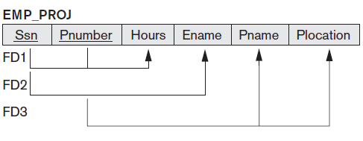
1. Ssn→Ename
2. Pnumber →{Pname, Plocation}
3.{Ssn, Pnumber}→Hours

Slide 14

A relation state of TEACH with a possible functional dependency TEXT → COURSE.
However, TEACHER → COURSE is ruled out.

Slide 15
Normalization of Relations
first proposed by Codd (1972)
Takes a relation schema through a series of tests to certify whether it satisfies a certain normal form
considered as relational design by analysis
1NF, 2NF, 3NF and BCNF are based on a single analytical tool.
5NF and 6NF are based on the concepts of multivalued dependencies and join dependencies

Slide 16
Normalization of data
Normalization of data can be considered a process of analysing the given relation schemas based on their FDs and primary keys to achieve the desirable properties of
minimizing redundancy and
minimizing the insertion, deletion, and update anomalies
It can be considered as a “filtering” or “purification” process to make the design have successively better quality.
Unsatisfactory relation schemas that do not meet certain conditions i.e. the normal form tests, are decomposed into smaller relation schemas that meet the tests and hence possess the desirable properties.

Slide 17
The normal form of a relation refers to the highest normal form condition that it meets, and hence indicates the degree to which it has been normalized.
Denormalization is the process of storing the join of higher normal form relations as a base relation, which is in a lower normal form.
An attribute of relation schema R is called a prime attribute of R if it is a member of some candidate key of R. An attribute is called nonprime if it is not a prime attribute that is, if it is not a member of any candidate key.
For instance a 3NF relation already satisfies 2NF and 1NF.

Slide 18
First Normal Form (1NF)
A relation will be 1NF if it contains an atomic value.
It states that an attribute of a table cannot hold multiple values. It must hold only single-valued attribute.
First normal form disallows the multi-valued attribute, composite attribute, and their combinations.

Slide 19
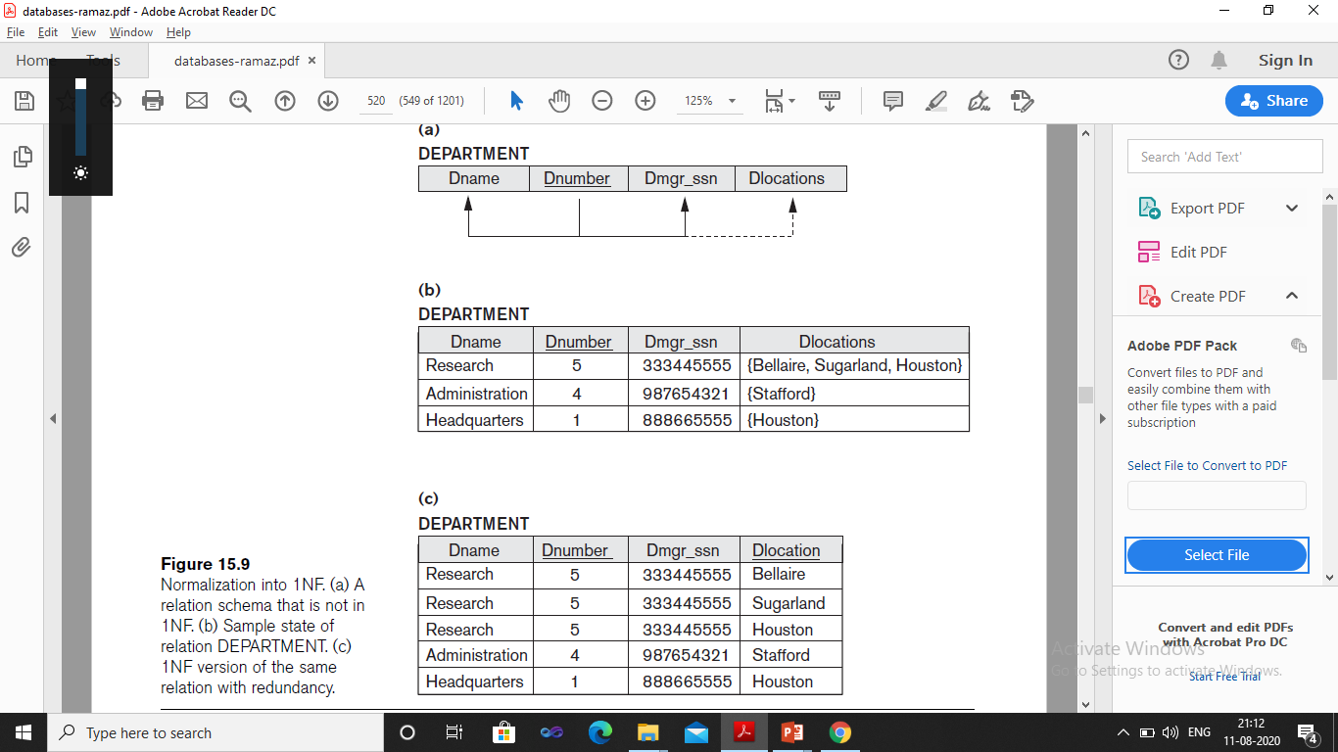

Slide 20
Second Normal Form(2NF)
In the 2NF, relational must be in 1NF.
Second normal form (2NF) is based on the concept of full functional dependency.
A functional dependency X → Y is a full functional dependency if removal of any attribute A from X means that the dependency does not hold any more.
A relation schema R is in 2NF if every nonprime attribute A in R is fully functionally dependent on the primary key of R.

Slide 21
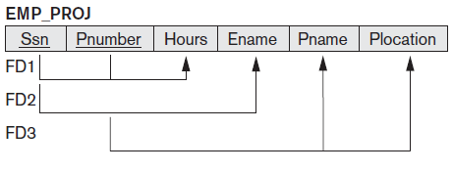
{Ssn, Pnumber} → Hours is a full dependency
(neither Ssn → Hours nor Pnumber → Hours holds).
However, the dependency {Ssn, Ename}→ Ename is partial
because Ssn→ Ename holds.

Slide 22
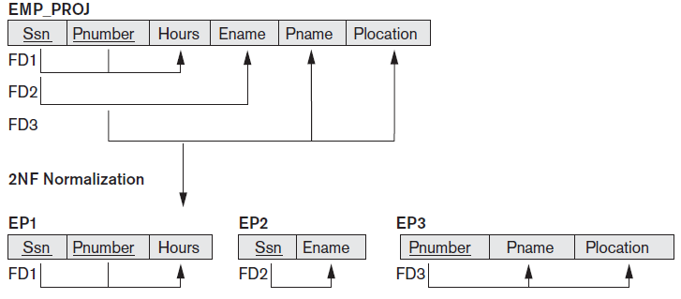

Slide 23
Third Normal Form(3NF)
Third normal form (3NF) is based on the concept of transitive dependency. A functional dependency X→Y in a relation schema R is a transitive dependency if there exists a set of attributes Z in R that is neither a candidate key nor a subset of any key of R and both X→Z and Z→Y hold.
According to Codd’s original definition, a relation schema R is in 3NF if it satisfies 2NF and no nonprime attribute of R is transitively dependent on the primary key.

Slide 24
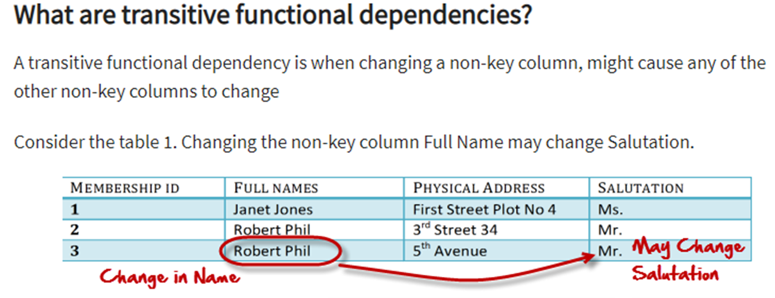

Slide 25
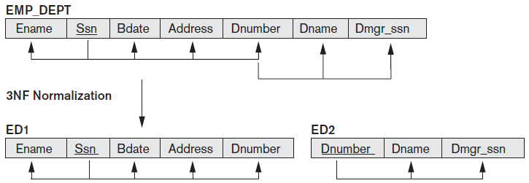

Slide 26
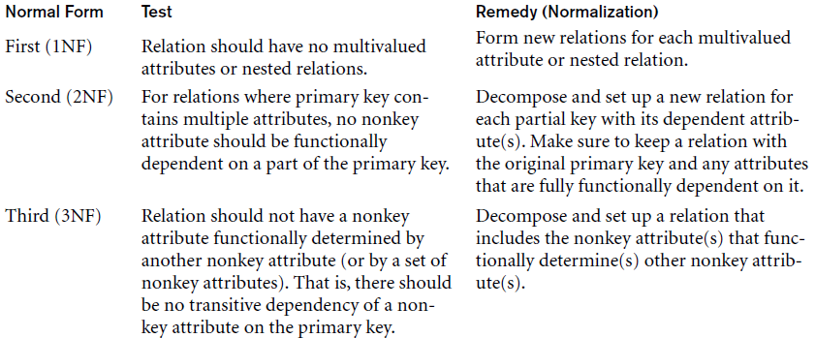

Slide 27
Boyce-Codd normal form (BCNF)
BCNF was proposed as a simpler form of 3NF, but it was found to be stricter than 3NF. That is, every relation in BCNF is also in 3NF;however, a relation in 3NF is not necessarily in BCNF.
A relation schema R is in BCNF if whenever a nontrivial functional dependency X →A holds in R, then X is a super key of R.
For BCNF, the table should be in 3NF, and for every FD, LHS is super key.

Slide 28
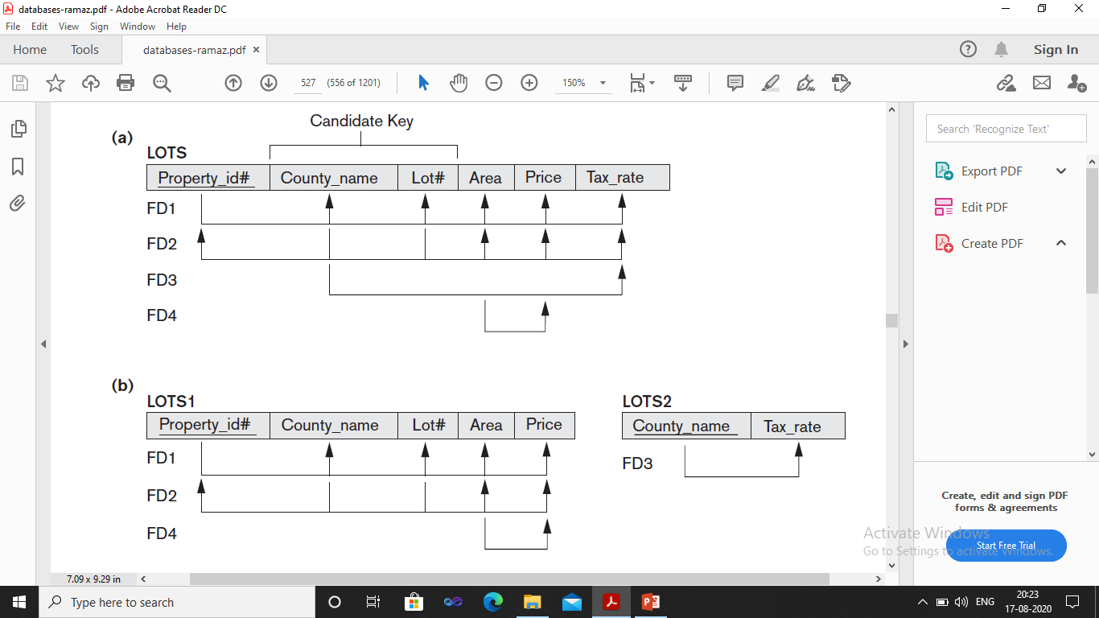

Slide 29
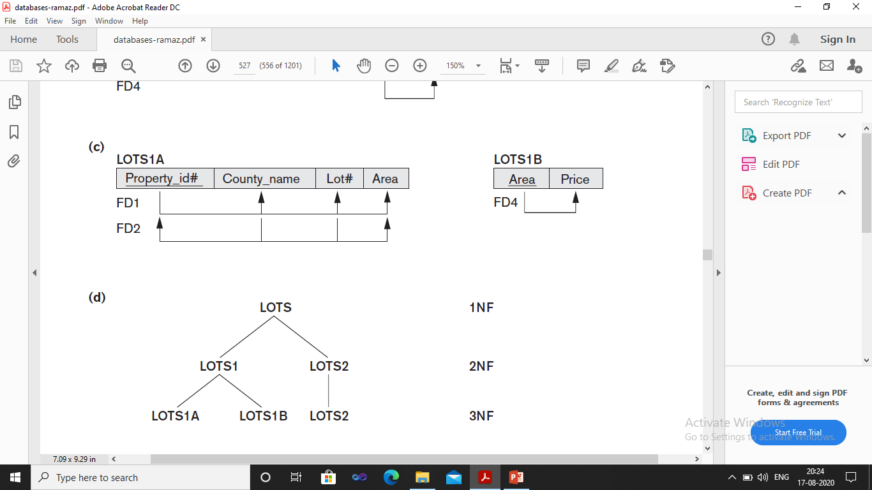

Slide 30
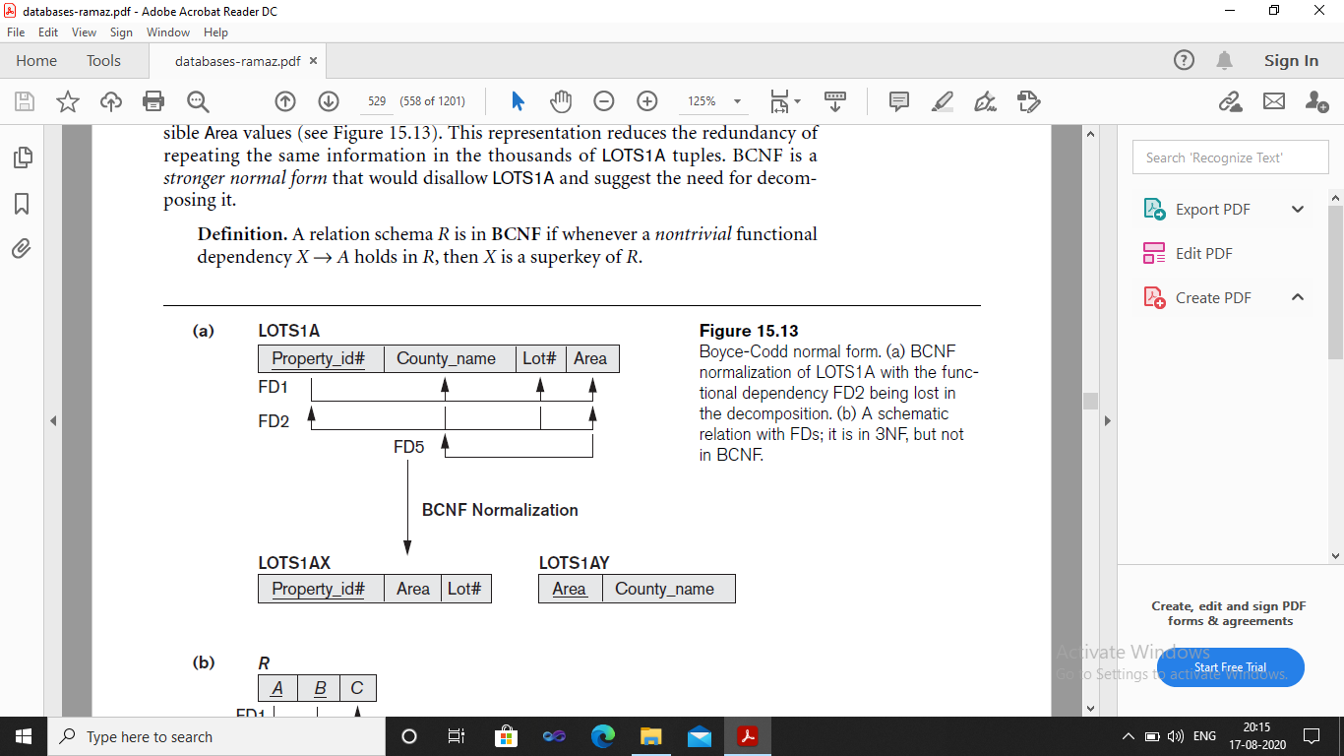

Slide 31
Fourth normal form (4NF)
For a dependency A → B, if for a single value of A, multiple values of B exists, then the relation will be a multi-valued dependency.
A relation will be in 4NF if it is in Boyce Codd normal form and has no multi-valued dependency.

Slide 32
Fifth normal form (5NF)
A relation is in 5NF if it is in 4NF and not contains any join dependency and joining should be lossless.
5NF is satisfied when all the tables are broken into as many tables as possible in order to avoid redundancy.
5NF is also known as Project-join normal form (PJ/NF).

Slide 33
Student ID | Student Name | Course ID | Course Name | Proj_ID | Proj_Name | Address | City | Zip Code | Phone No
Primary Key : Student ID
FD1 Student_ID → Student_Name
FD2 Project_ID → Project_Name
FD3 Course_ID → Course_Name
FD4 Student_ID → Project_Name,Course_Name
FD5 Student_ID→ Address where Address → City and City → Zip Code
Notes:
FD1 Student_ID → Student_Name
FD2 Project_ID → Project_Name
FD3 Course_ID → Course_Name
FD4 Student_ID → Project_Name,Course_Name
FD5 Student_ID → Address where Address →City and City → Zip Code

